Slide 1

Log File Management
Standard Log File Format
(Vs. 1.0 – Oct-2016)

Slide 2
Target of Task
Today‘s Target
Define a standard log file format!
(syntax definition)

Slide 3
Recap: Project Outline
Phase 1
Define a core log file management system comprising core format and core file organization ^{*)}
Setup a log file management key group
Align core definitions with key group
First alpha test
Phase 2
Define log file format specifics with key group
Each new logging has to be implemented according to core format and format specifics
Phase 3
Define file organization with key group
Implement log file management dialogs in machine SW (library)
Each new logging has integrated log file dialogs
Phase 4
Case-by-case backward integration of log file management
Case-by-case implementation of data base functionality
*) already done (HUPR, FLSP, EMSO)

Slide 4
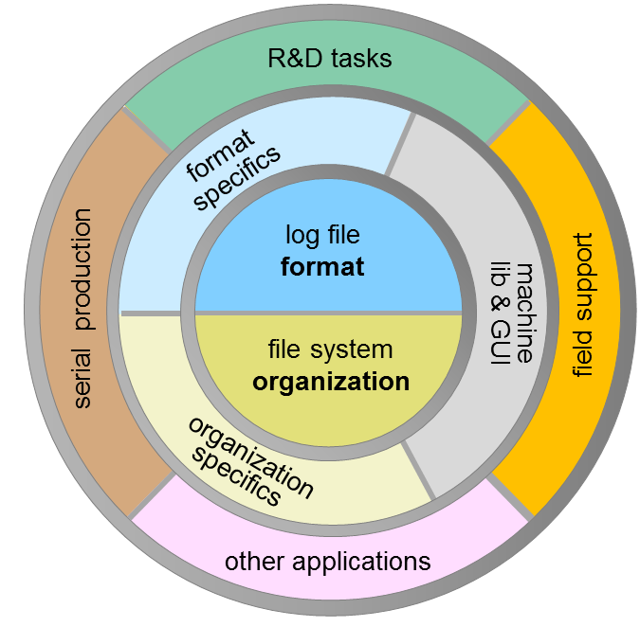
Definition & Implementation in Layers
Log File Management Structure
Core Layer
log file format
file system organization
2) Specifics Layer
format specifics
organization specifics
3) Application Layer
R&D tasks
field support
serial production
other applications
Today‘s focus

Slide 5
Log File Format
Definition
Format syntax
Format semantics (later!)

Slide 6
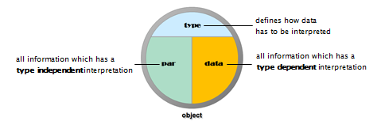
Information Structure of a Log File
Log files contain a bulk of information which can typically be categorized as follows
type: tells us how data has to be interpreted
parameter: information which has a type-independent interpretation (like title, comments, date, time, rows, columns, machine-ID, …)
data: all information which has type dependent interpretation

Slide 7
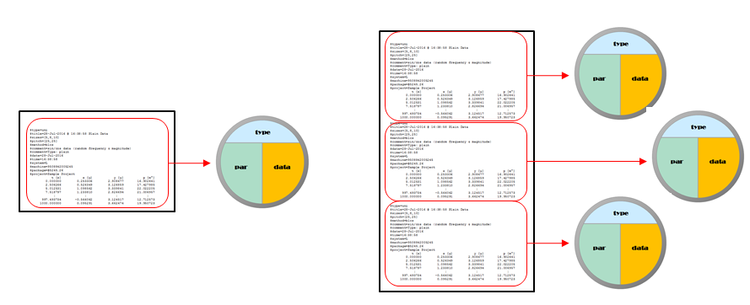
Object Structure of a Log File
A log file may be organized into log file chunks, which are called log objects
Each log object refers to type, parameter and data of a particular test (figure 3).
At the core definition level there is some freedom whether a sequence of log file information chunks is logged into a single log file as a sequence of log file objects, or each part of the sequence is logged into a distinct log file representing only a single object

Slide 8
Log File Examples
$type=uni
$title=‘28-Jul-2016 @ 16:38:58 Plain Data’
$sizes=[5,8,10]
$pitch=[25,25]
$method=‘blcs’
$comment=‘sin/cos data (random frequency & magnitude)’
$comment=‘Type: UNI’
$date=‘28-Jul-2016’
$time=‘16:38:58’
$system=‘L’
$machine=‘9508842005245’
$package=‘@5245.26’
$project=‘Sample Project’
; t [s]; x [µ]; y [µ]; p [m°];
; 0.000000; 0.253306; 2.908677; 16.902641;
; 2.506266; 0.526349; 3.126859; 17.427985;
; 5.012531; 1.098562; 3.339841; 22.022205;
: : : :
; 1000.000000; 0.095291; 3.662474; 19.950723;
$type=uni
$title=28-Jul-2016 @ 16:38:58 Plain Data
$sizes=[5,8,10]
$pitch=[25,25]
$method=blcs
$comment=sin/cos data (random frequency & magnitude)
$comment=Type: UNI
$date=28-Jul-2016
$time=16:38:58
$system=L
$machine=9508842005245
$package=@5245.26
$project=Sample Project
t [s] x [µ] y [µ] p [m°]
0.000000 0.253306 2.908677 16.902641
5.012531 1.098562 3.339841 22.022205
7.518797 1.233810 2.826694 21.006957
: : : :
1000.000000 0.095291 3.662474 19.950723
a) log file format with standard syntax
b) log file format with simplified syntax
$type=uni
$title=28-Jul-2016 @ 16:38:58 Plain Data
%
% these are three comment lines
%
$comment=sin/cos data (random frequency & magnitude)
$comment=Type: UNI
$date=28-Jul-2016
$time=16:38:58
$system=L
$machine=9508842005245
$package=@5245.26
$project=Sample Project
$shape.kind='circle'
$shape.color.line='b'
$shape.color.fill='y'
$shape.width=[3]
$junk={[0,1.5],(struct('kind',[1],'color',(struct('line','b','fill','y'))))}
%
% the data header is a sequence of symbols followed by the unit in brackets
%
t [s] x [µ] y [µ] p [m°]
0.000000 0.253306 2.908677 16.902641
997.493734 -0.566062 3.124517 12.712573
: : : :
1000.000000 0.095291 3.662474 19.950723
c) log file format including comments, structures and lists

Slide 9
Log File Syntax
Log files have to be represented by readable text files
A log file contains one or more log objects
log file
log object
A log object contains optional parameter lines, an obligatory header line and one or more data lines
comment
parameter
comment
header
log object
data line
Comment lines can be placed at any line position of the log file. A comment line starts with a ‘%‘ character, proceeded by any characters (zero or more)

Slide 10
More Syntax Details
.
parameter
$
identifier
=
identifier
value
identifier
[
unit
]
header
separator
identifier
[
unit
]
separator
datarow
data
separated datarow
datarow

Slide 11
Value Syntax
A value can be either string, numeric, or of type cell array
String values follow either the MATLAB string literal syntax or follow a simplified string literal syntax which is without enclosing quotes.
Examples: '5245.26', '28-Jul-2016'
If a string value is with simplified syntax, it must not begin with a parenthesis ‘(‘, bracket '[' or brace '{'.
Numeric literals are always enclosed in brackets and can to follow any MATLAB syntax which defines a matrix value
Examples: [3.14159] or [6,10,8] or [3 4 5; 7 8 9]
Cell arrays are terminated by braces (‘{‘,’}’) and must follow a valid MATLAB syntax
Examples: {'abc', 5, NaN; inf, pi, [5 6; 7 8]}
{[0,1.5],(struct('kind',[1],'color',(struct('line','b','fill','y'))))}

Slide 12
Miscellaneous
Even a log file may contain multiple log objects it is prefered to have one log object per log file
Do not use any non ASCII characters (like ä,ö,ü,µ,€,²,...), as they will generate compatibility if analysed on different operating systems. E.g. use ‘[u]‘ for ‘micron‘ unit instead of ‘[µ]‘
Use periods (‘.‘) for decimal ‚comma‘! Comma (‘,‘) for decimal ‚comma‘ is not allowed!

Slide 13
Log File & Folder
Organization
Core Organization
Organization specifics (proposal)

Slide 14
Basic Organization Structure
Log files are always contained in log packages (simply: packages)
Packages are (uniquely) identified by a package ID.
The package ID starts with a ‚@‘ character followed by the last for digits of the machine number plus a continued number separated by a period (e.g. @4567.28 or @2377.2)
A package is represented as a folder with a specific naming syntax that contains one or more log files, optionally supported with additional files.
The naming syntax of a package name is
The text must comply to allowed file name characters
Examples: @4567.28.VIB Vibration tests left&right, @4567.28.MBC
package ID
@
fourdigits
.
integer
.
package name
package ID
.
type
text
_

Slide 15

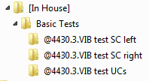


Log File Types
There is a unique (extendable) list of type identifiers
If a log file contains information of multiple log objects, all log objects must be of the same type
A package folder can only contain log files of the same type, which has to match the type information incorporated in the package folder name
Example
contains
contains
contains

Slide 16
Project Context Transition
initial
context
new project
new project
open project
new package
default
context
open project
project
context
run a test
close project
run a test

Slide 17
Project Context Control
begin test
no
yes
project context
parent folder
for new package folder
is type subfolder
of log root
parent folder
for new package
folder is current
project folder
test type
changed?
create new package
folder in proper
parent folder
perform test and log data
end test

Slide 18
Appendix

